Slide 1



W / Friends
Keep in touch everywhere with your friends!

Slide 2
Index
3. Introduction
4. Front-end Style
6. Traffic Monitoring
7. Server
8. Database
9. Head of back-end
13. Security
17. Android mobile app
18. Gantt Chart
20. Expectations
21. Prototype
22. Conclusion

Slide 3
Netherlands Project
This project is a collaboration between “mboRijnland” and “City College of Plymouth” that allows students to work and learn together.
The web application we are developing is called “W/ Friends”.
It is a web social application with the practical main function designed to help friends meet.
The map-based software will show you where your “friends” are and will allow to chat with them and set meeting points for specific events. In addition, users are also able to write specific tailored reviews of places such as restaurants, pubs, clubs and shops created by your “friends”.
Pick a place to meet your friends (GPS system)
See where your friends are going to
Personal specific recommendations/ratings of places on the map
Our target audience is age 16+
6-digit code to add each other as friends (QR code can be added to manage friend requests)
Secure login/register page (CAPTCHA I am not a robot)
Chat with people in proximity.

Slide 4
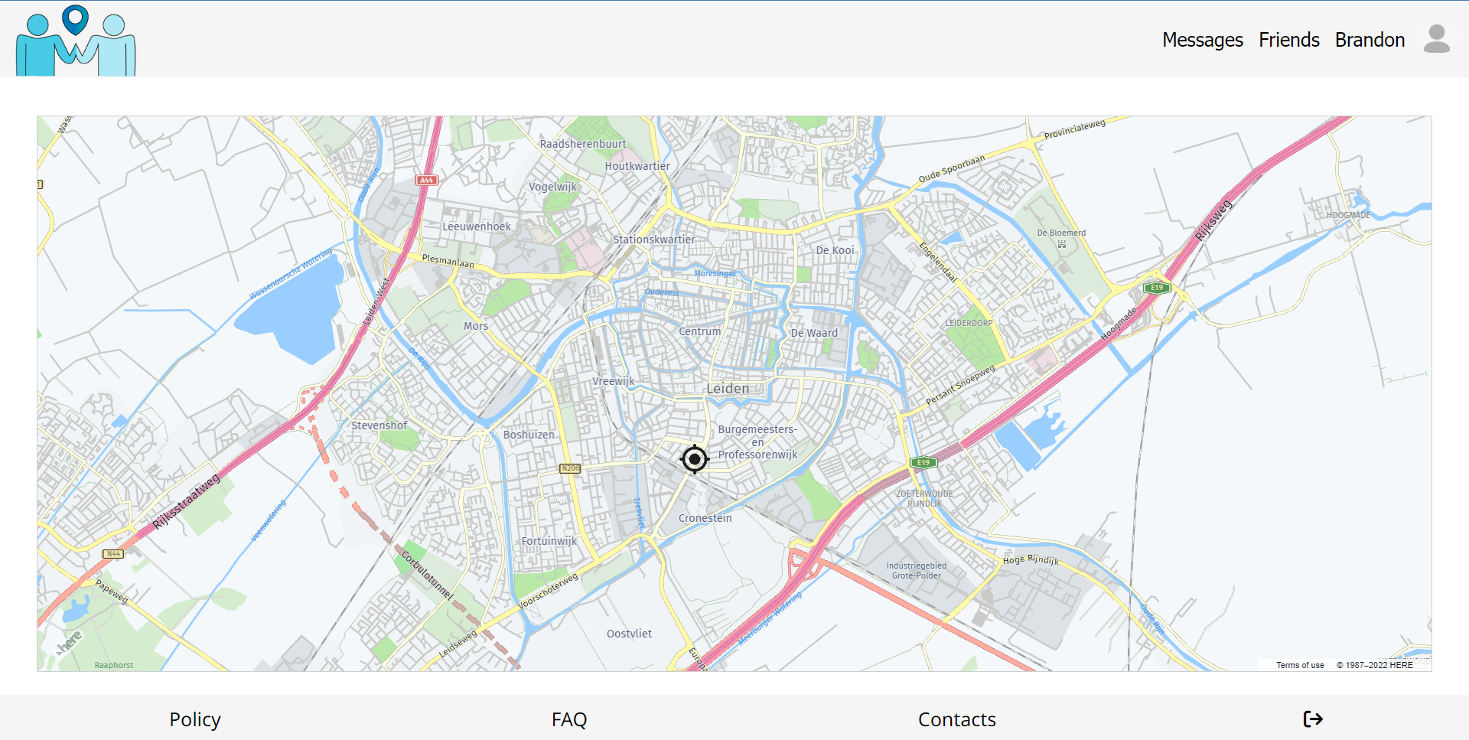
Front-end Style

Slide 5
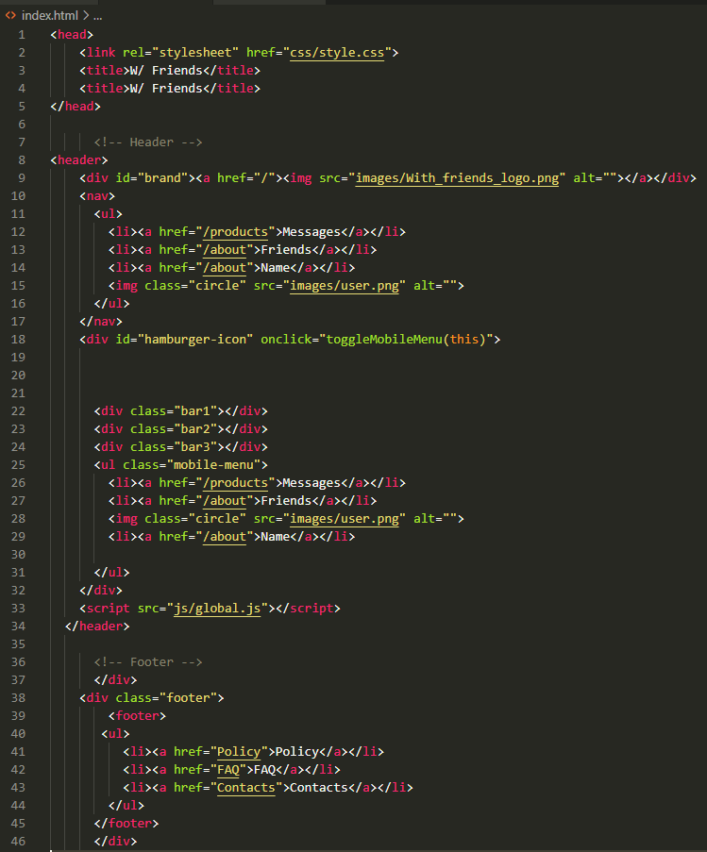
Front-end Style

Slide 6
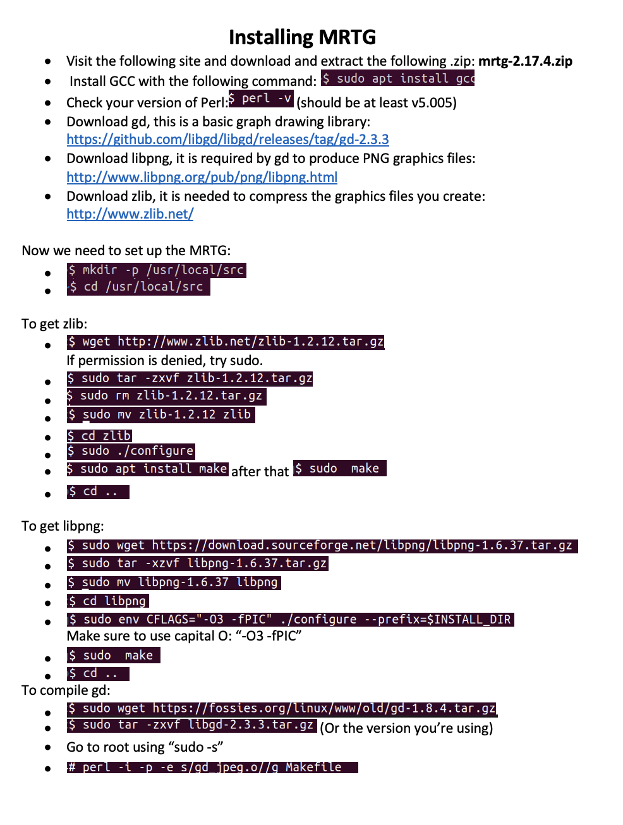
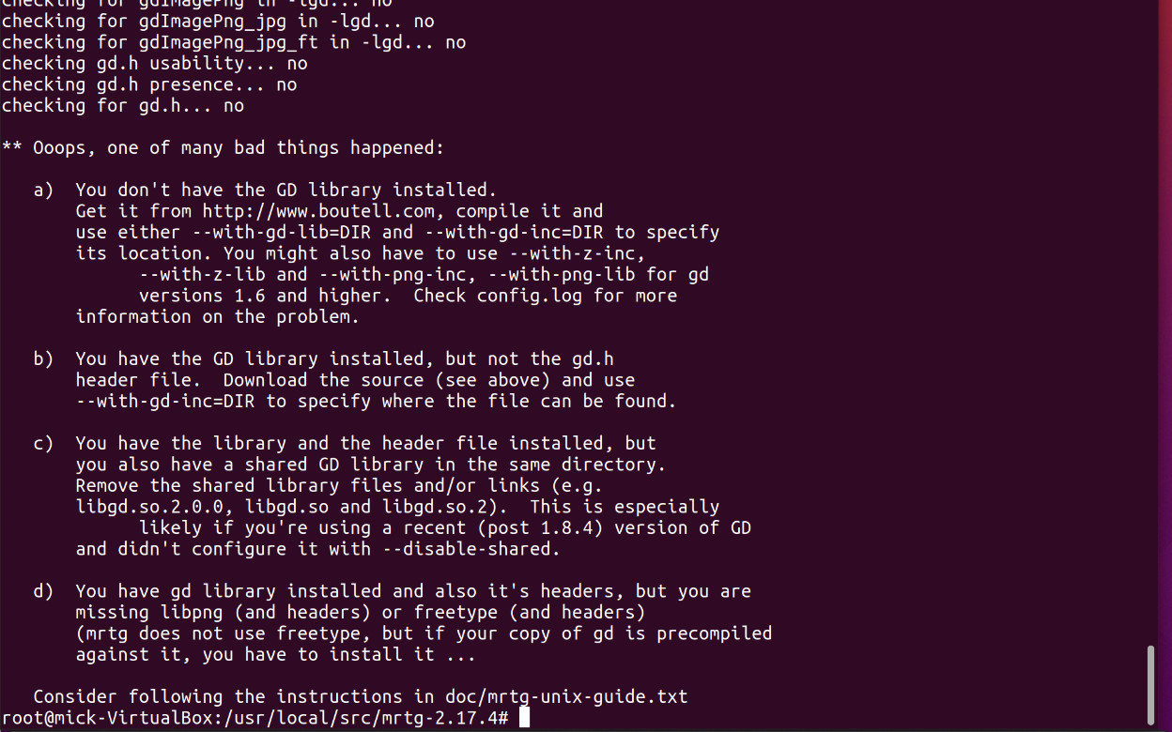
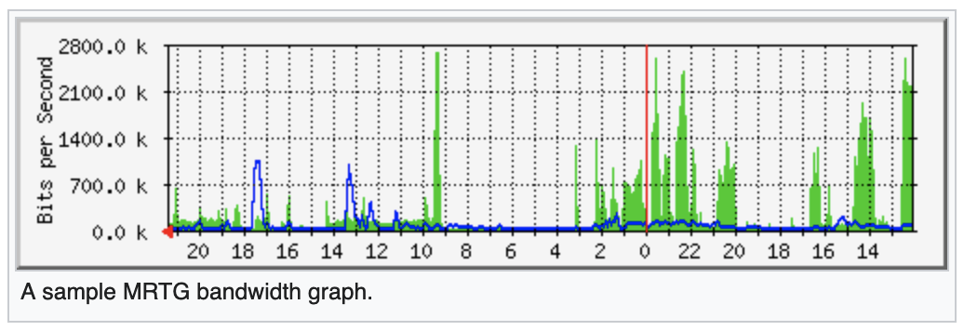
Traffic Monitoring

Slide 7
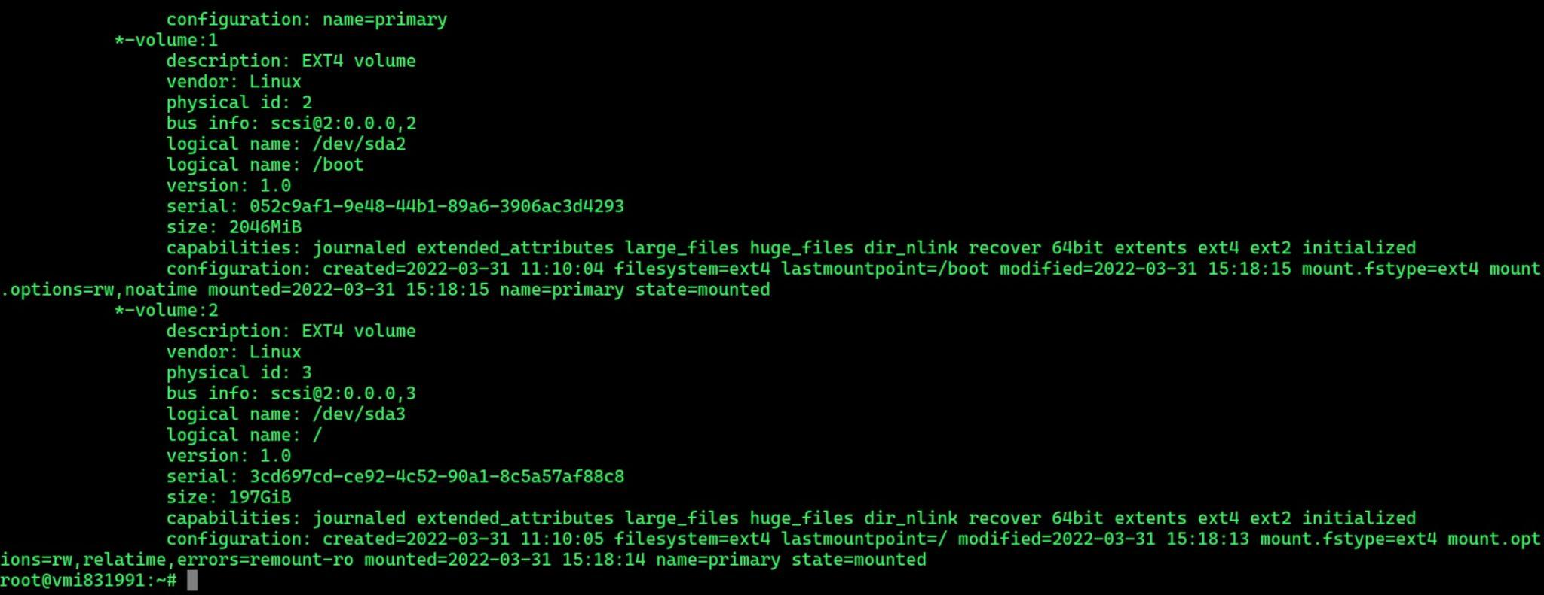
Server

Slide 8
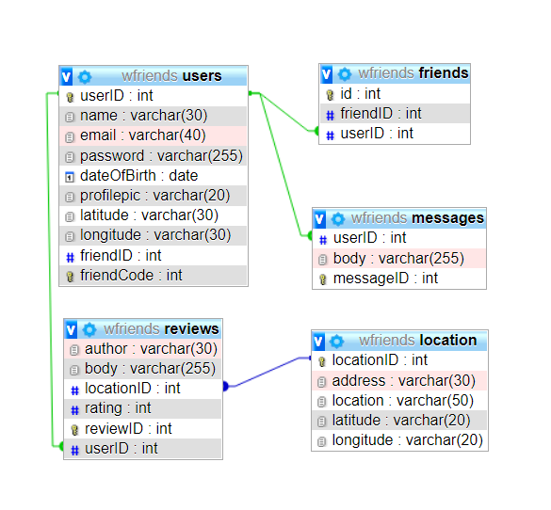
Database

Slide 9
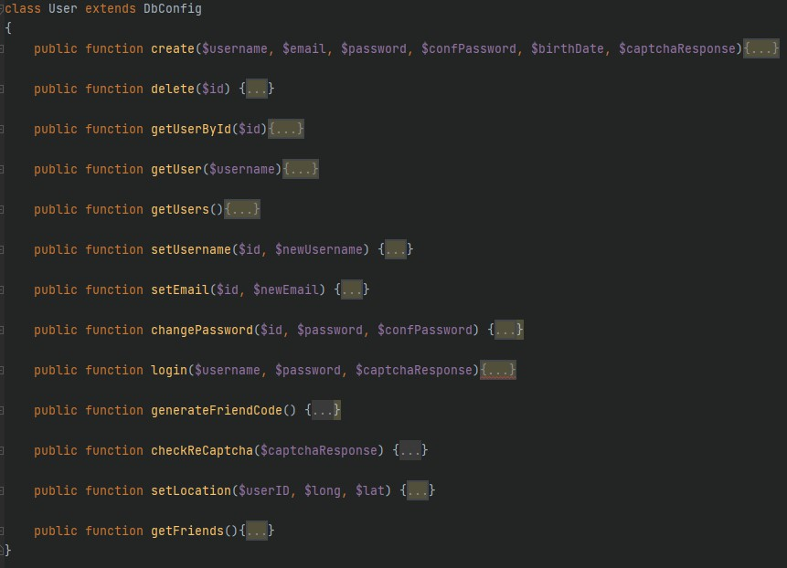
Head of back-end

Slide 10
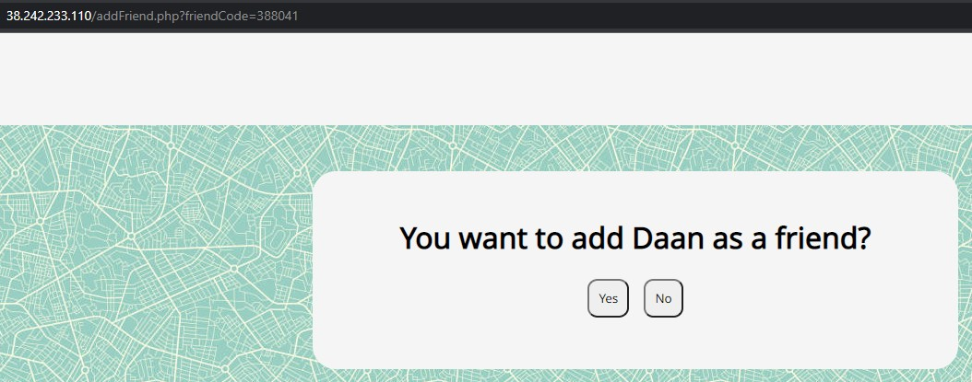
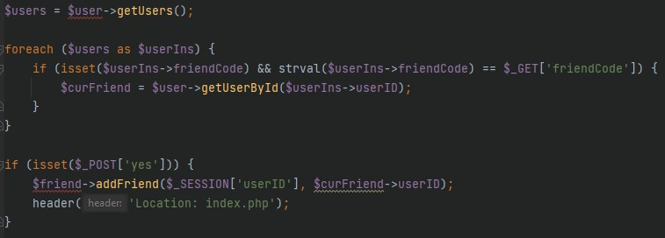
Head of back-end

Slide 11
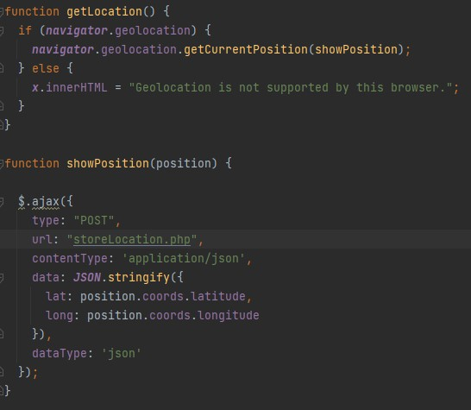
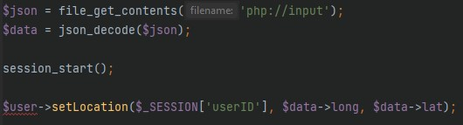
Head of back-end

Slide 12
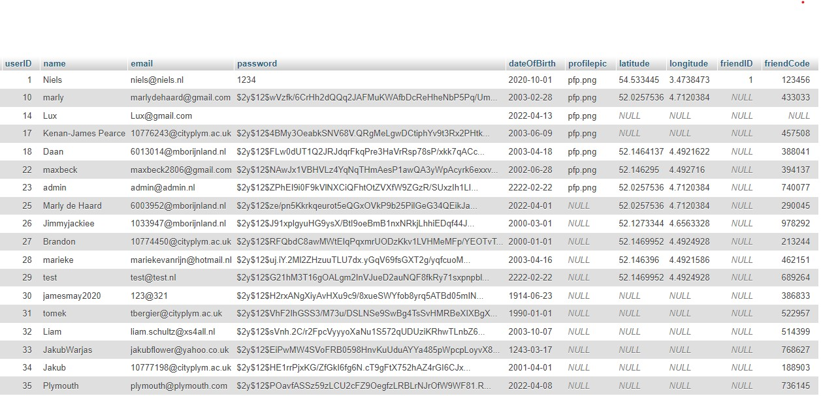
Head of back-end

Slide 13
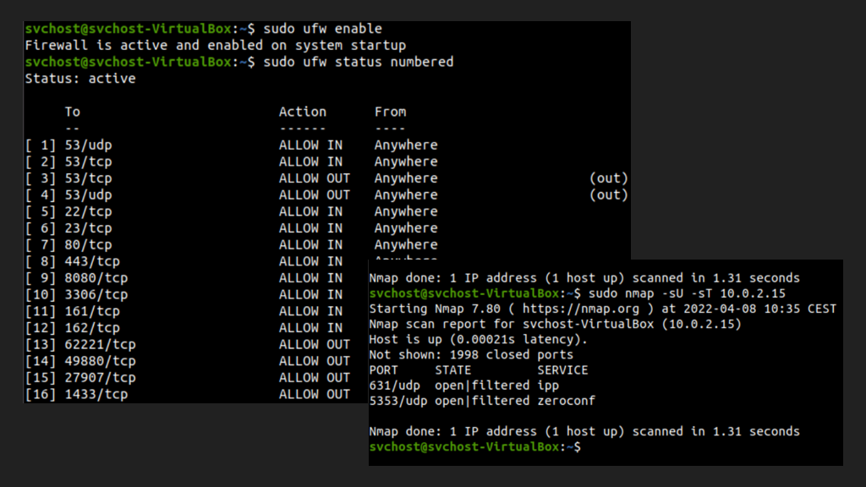
Security

Slide 14
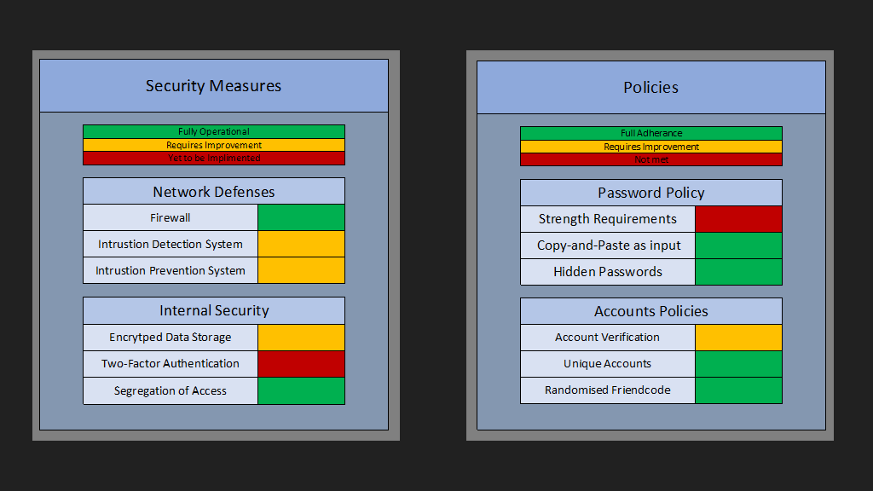
Security

Slide 15
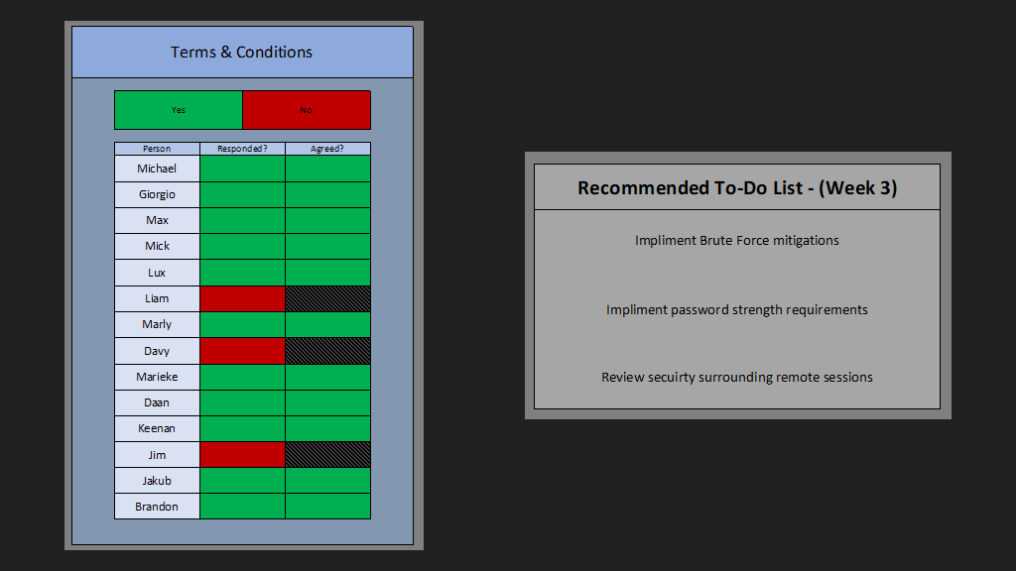
Security

Slide 16
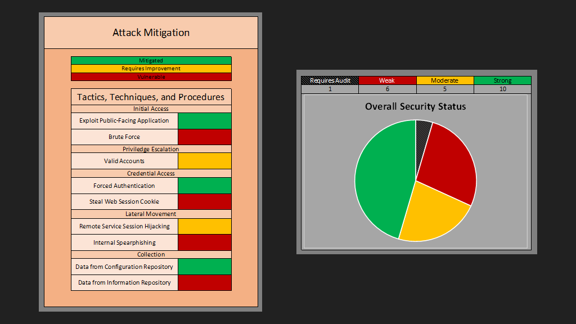
Security

Slide 17
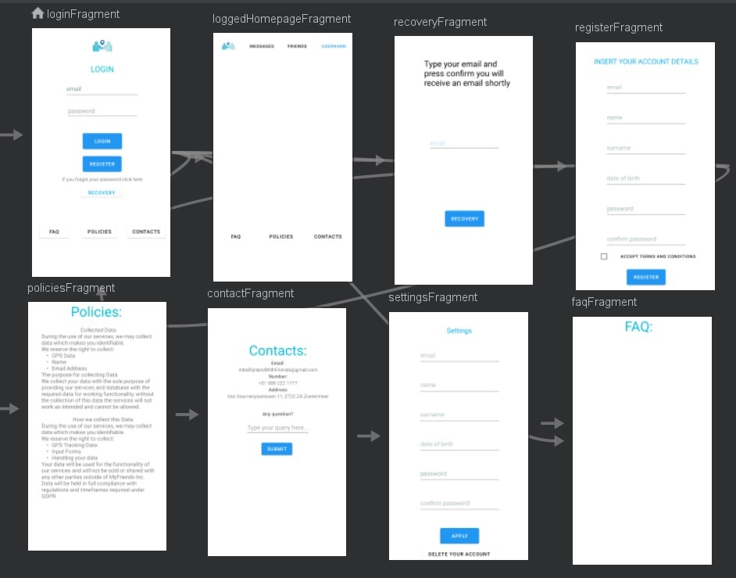
Android mobile app

Slide 18
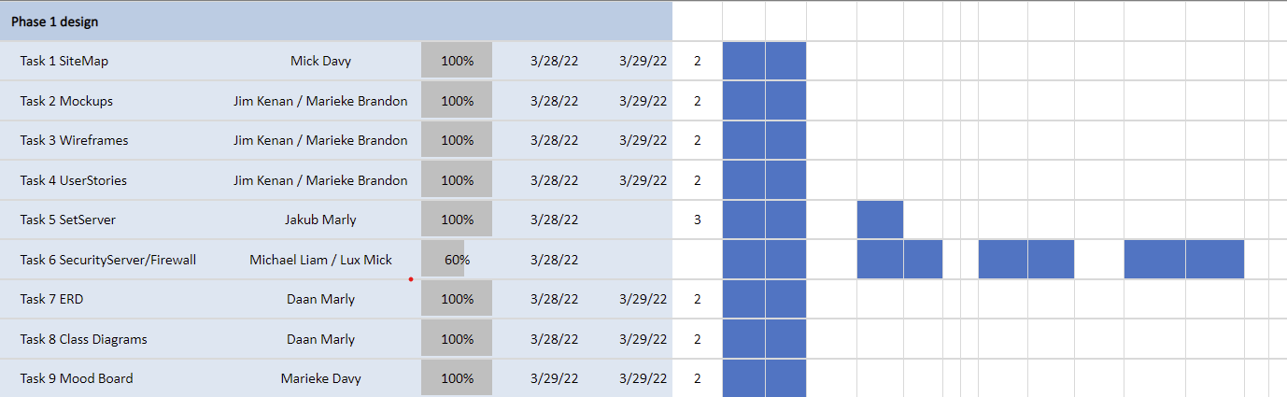
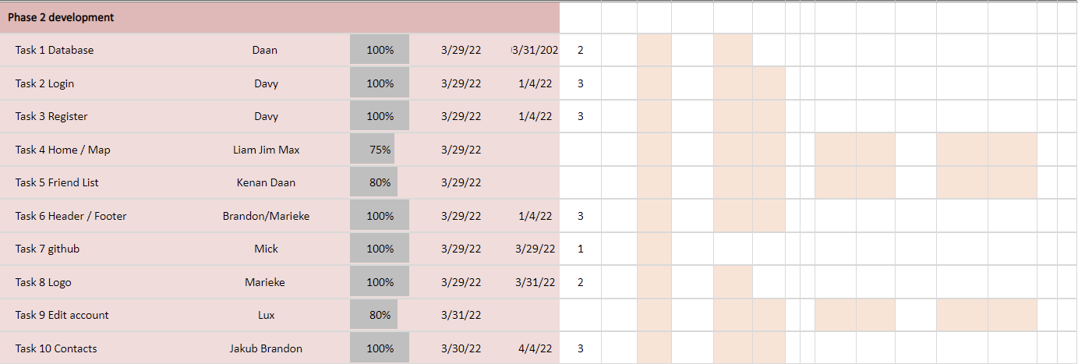
Gantt Chart

Slide 19
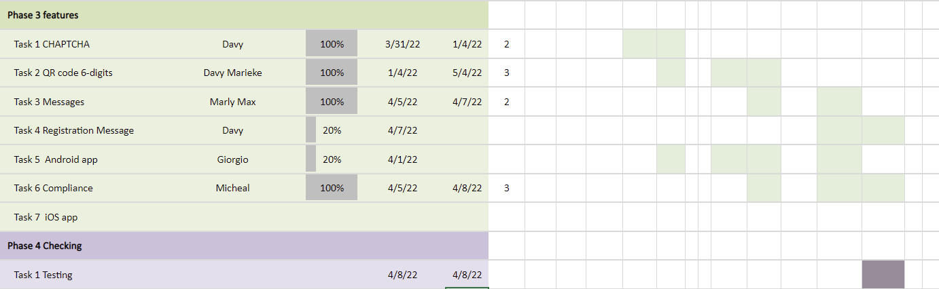
Gantt Chart

Slide 20
Expectations
For this project our expectations are:
Understanding how to work in teams
Learning about several technologies
Delivering an almost fully prototype implementing complex features
Make new friends!

Slide 21
Prototype
http://38.242.233.110/

Slide 22
Conclusion
We would like to thank all of you for your hospitality and for participating at our presentation
QUESTIONS??

